Slide 1
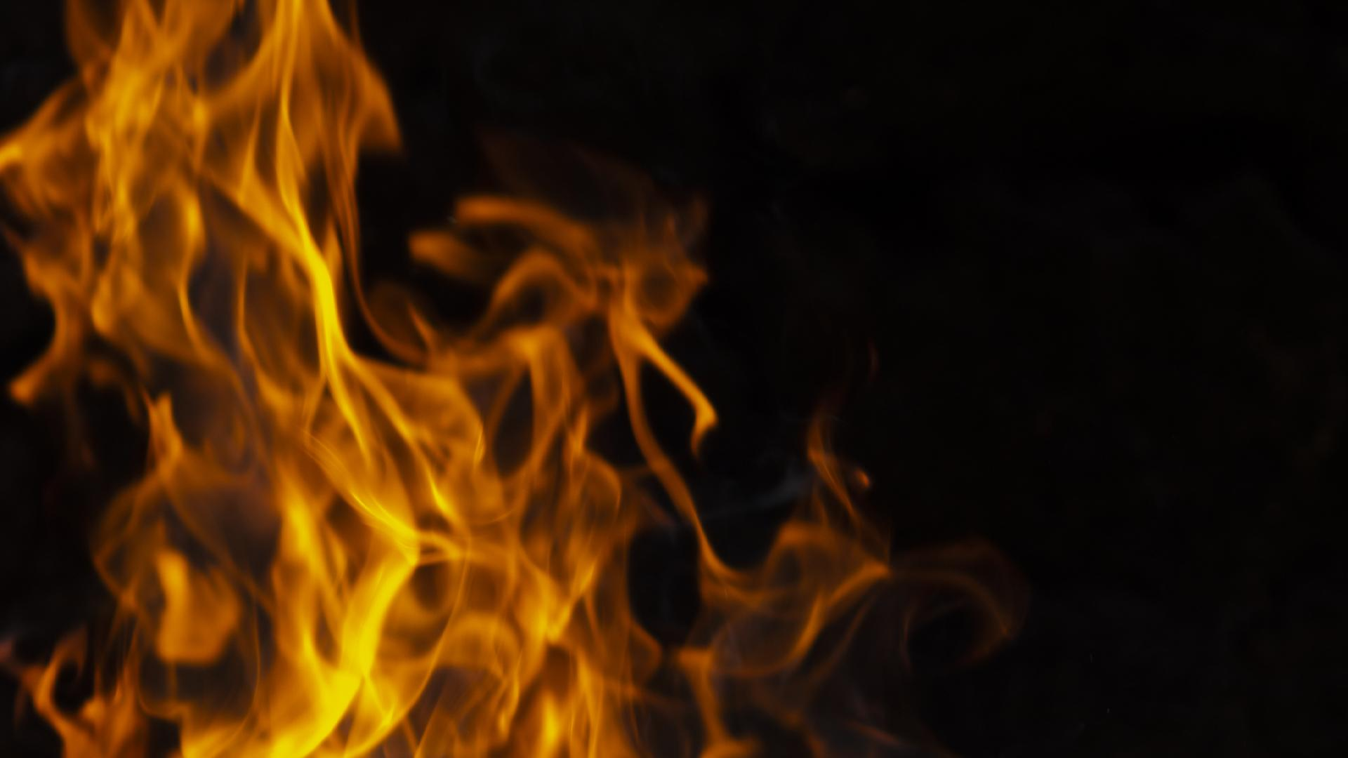
Fire classification
Team 5 – Yu (Kathy) Xu, Huawan (Zoey) Zhong,
Phunsok Norboo, Quan Nguyen

Slide 2
Table of Contents
Motivation & Background
Neural Network Models & Architecture
Challenges &
Next STEPs
1
2
3
4
5
Data Introduction
Model Performance

Slide 3
1
Motivation & Background

Slide 4
Motivation & Background
Enhances Emergency Decision-Making:
Quickly estimates fire severity (small, medium, large) based on images.
Wide Range of Applications:
Integrates with drones, smart city surveillance, and forest monitoring systems.
Direct Beneficiaries:
Firefighters, emergency dispatchers, park rangers, and first responders.
Critical Impact:
Real-time, accurate fire severity detection helps save lives and minimize damage.

Slide 5
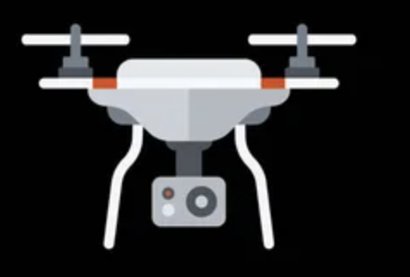

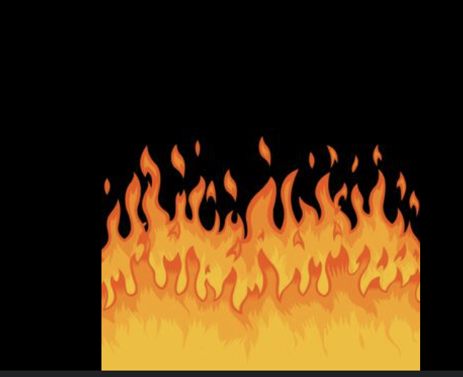
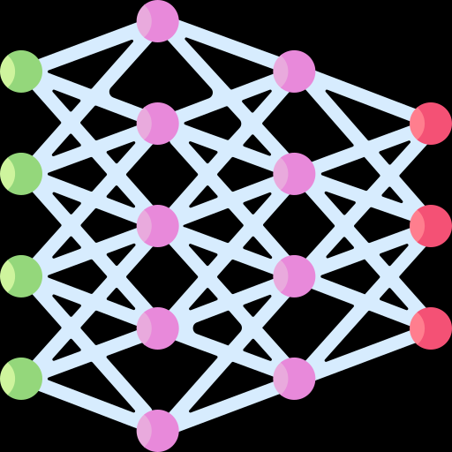

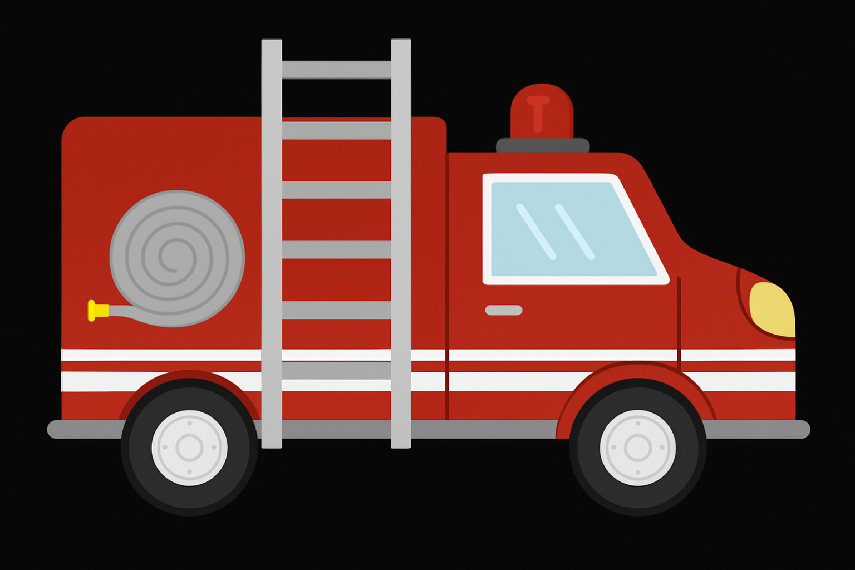

Notes:
Only need one click here

Slide 6
2
Data Introduction

Slide 7
Data information
Source
four labels
Size
From real scenes, such as fire incidents and experimental settings.
large, medium, small, and other
9462 frames

Slide 8
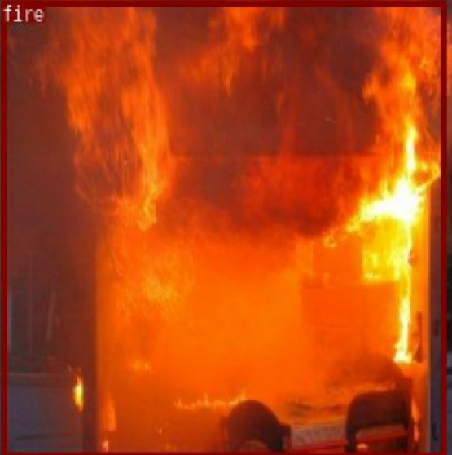
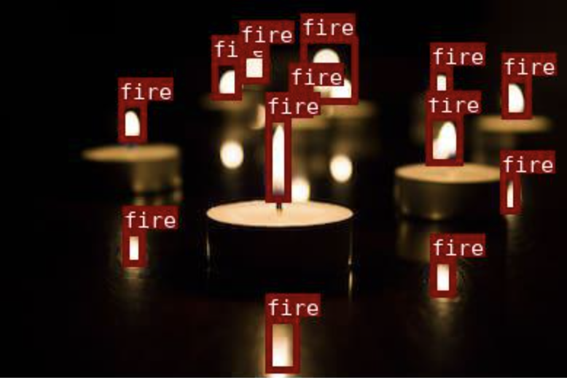
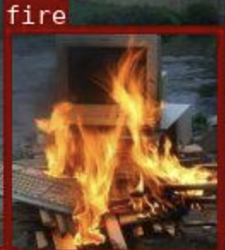
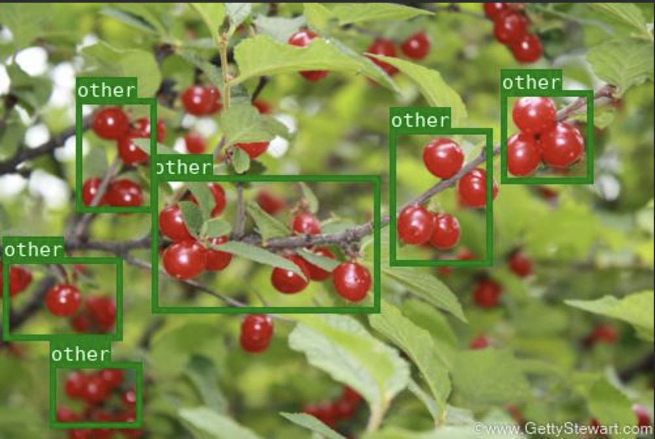
Image Sample
Small
Small
Middle
Large
Other

Slide 9
Data preprocessing
Excluded 'other' class to ensure image-based learning:
Including it would bias the model to
rely on text patterns.
(About 7305 images left)
Label Encoding:
Convert string labels to numeric
Resize image:
224 * 224 pixels
Train-Validation Split:
Train: 70%; Test: 30%
Handle Class Imbalance:
Upweight minority class
Label | middle | large | small
Count | 4722 | 3357 | 349

Slide 10
3
Neural Network Models & Architecture

Slide 11
Model Compiler
Optimizer | adam
Loss | sparse_categorical_crossentropy
Metrics | accuracy
Notes:
We use Adam as the optimizer as it optimizes training by combining adaptive learning rates with momentum, resulting in faster and more stable convergence.
Also, as we are a multiple class classification, the loss should be sparse_categorical-crossentropy. And the metrics, with no doubt, using accuracy

Slide 12
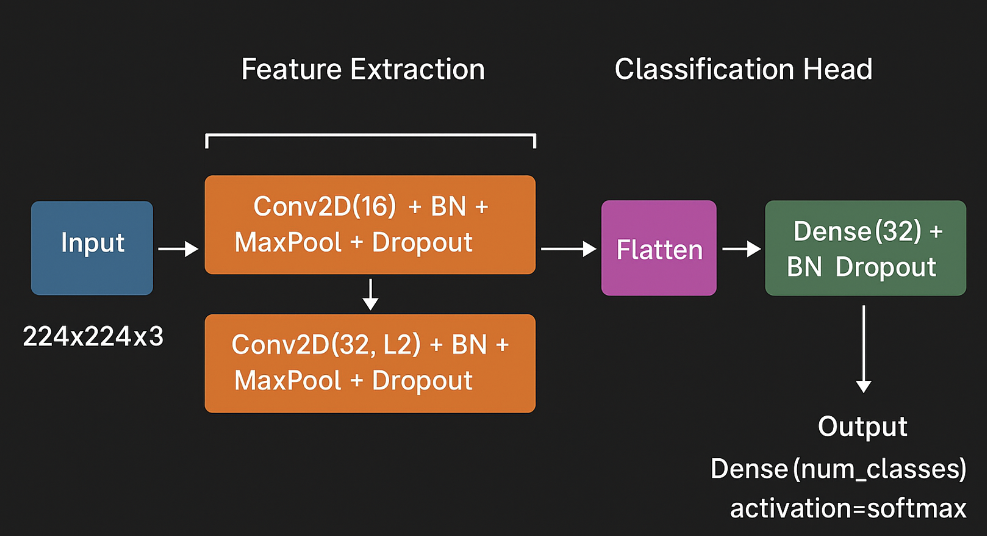
CNN Model
Notes:
The is the CNN model, as Zoey mentioned before, the input shape for us was settled in the data augmentation part, and then we create a simple CNN model with only two layers for feature extraction. And we we have a flatten layer to connect the convolution layers and the dense layer. Finally we have the output here with activation function of softmax. The rough draft we first applied showed the severe problem of overfitting. So we decided to add batchnormalization, dropout, and kernel.regularizer in the layer after input layer, trying to solve the overfitting problem. However, even we tried so many times, the overfitting problems still exist. However, we are thinking that CNN might need attention to specific feature maps instead of total things, so we decide to have a try.

Slide 13
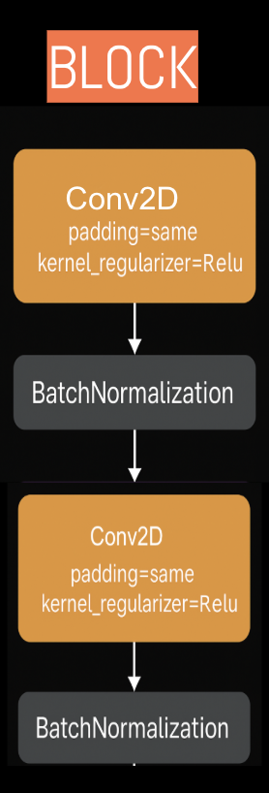
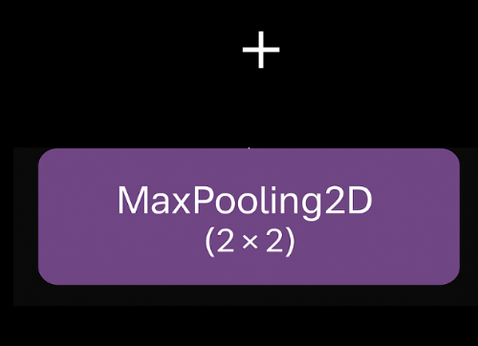
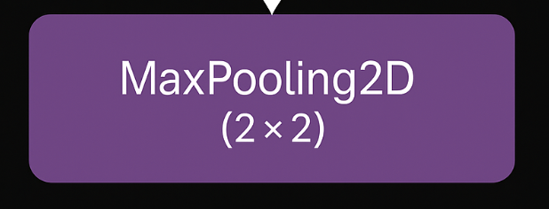
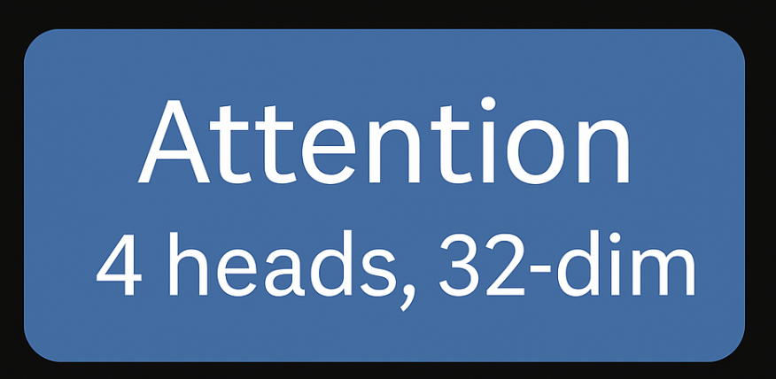
CNN + Attention Model
BLOCK1
Conv2D(32)
BLOCK2
Conv2D(64)
BLOCK3
Conv2D(128)
Input
+
½ BLOCK3
Conv2D(128)
output
Add
Residual
Residual
Notes:
Why 3 blocks of conv: we use three conv layer at the beginning for the model to extract as many features in the graph, with the maxpooling to reduce the spatial dimensions of the features.
Why block3 doesn’t maxpooling：becuase we need to preserve higher spatial resolution in the deeper layer as this is really important for the attention model, maxpooling will reduce the spatial dimensions of feature maps. With higher resolution feature maps, the attention model can better capture the local and global features.
Why multi-head attention model: right now we use multi -head attention models, the unit of multi-head attention model is QKV Self-Attention, and it is the only method that simultaneously dominates in speed, accuracy, and stability. In addition, the attention model was taught based on text data, but the image data is much more complex than text data. So we decided to use multi - head attention model here. This enables model to catch different details from multiple perspectives and scale at the same time.
Why adding a conv layer after attention layer ：Attention tells you where to look, Conv digs deep into those important regions.
Why we need a residual layer：Residual help the model learn new features without forgetting important existing information, prevent gradient vanishing, and speed up convergence!
We did reshape before and after the attention model to make sure the output and the conv2D after attention has the same scale. Also to avoid overfitting, we add batchnormalization, regulizer, and dropout layers in relevant layers, and this time the model is successful without overfitting problems.
The procedure’s not shown here, but to make sure the model can learn enough, we use early stopping based on loss as loss is more sensitive and reliable than accuracy for detecting overfitting, making it a better signal for early stopping
The result for this model is good, but maybe it can be improved with attention model + transformers, so we decide to make one.

Slide 14
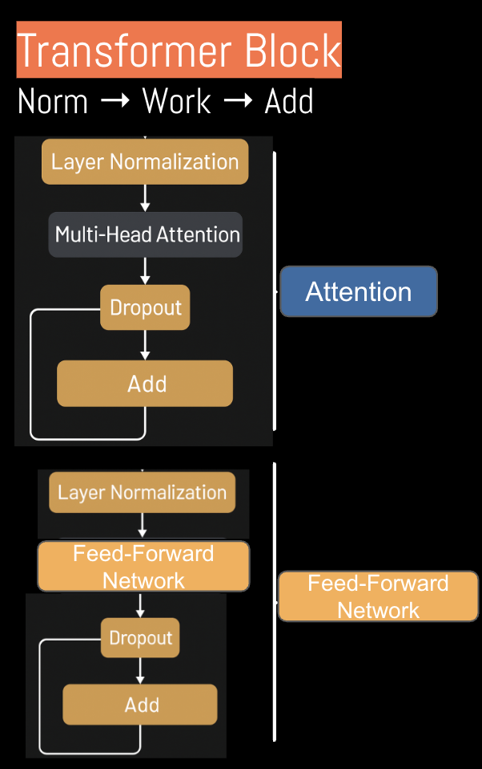
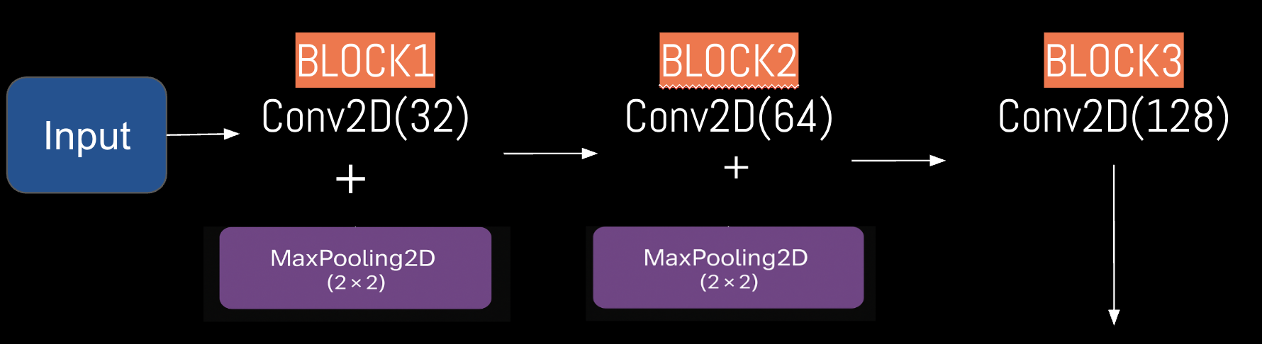
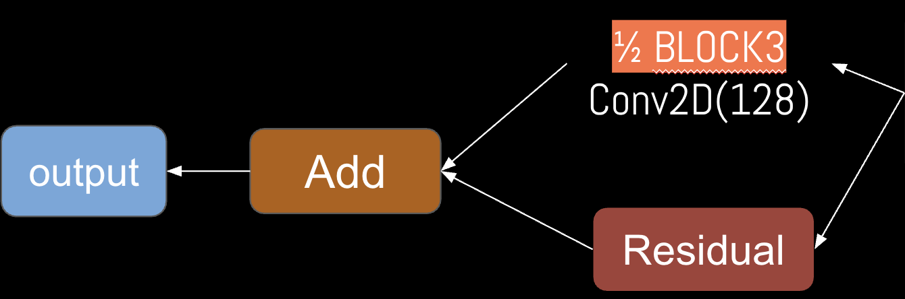
CNN + Attention + Transformer Model
Transformer
Notes:
The transformer block, didn’t contain in the class coding materials, so we asked ChatGPT to give us an example. Here is the transformer block.
It contains two parts, the first part is just the attention part, and the second part is feed-forward network part.
What is feed-forward network: is a simple neural network layer that applies two dense (fully connected) layers independently to each position in the sequence.
Why using feed-forward network: Independently enhance the complexity and expressive power of each position's features. It complements the cross-position communication handled by the Attention mechanism, enabling the model to become more intelligent and refined.

Slide 15
Pretrained model
ResNet50
MobileNetv2
Low accuracy,
Not a final choice

Slide 16
4
Model
Performance

Slide 17
Model Performance
 | Accuracy | Validation Accuracy
CNN | 0.8691 | 0.6655
CNN + Attention | 0.6929 | 0.6817
CNN + Attention with Transformer | 0.7004 | 0.7280
ResNet50 | 0.6521 | 0.6584
MobileNetV2 | 0.3752 | 0.5603
Notes:
Should add one sentence that the loss for CNN + Attention with Transformer is also the lowest, but not shown here.

Slide 18
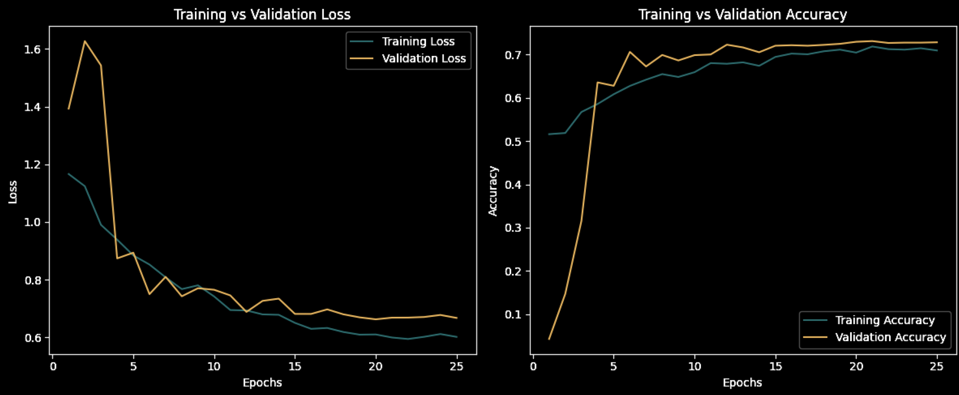
CNN + Attention with Transformer

Slide 19
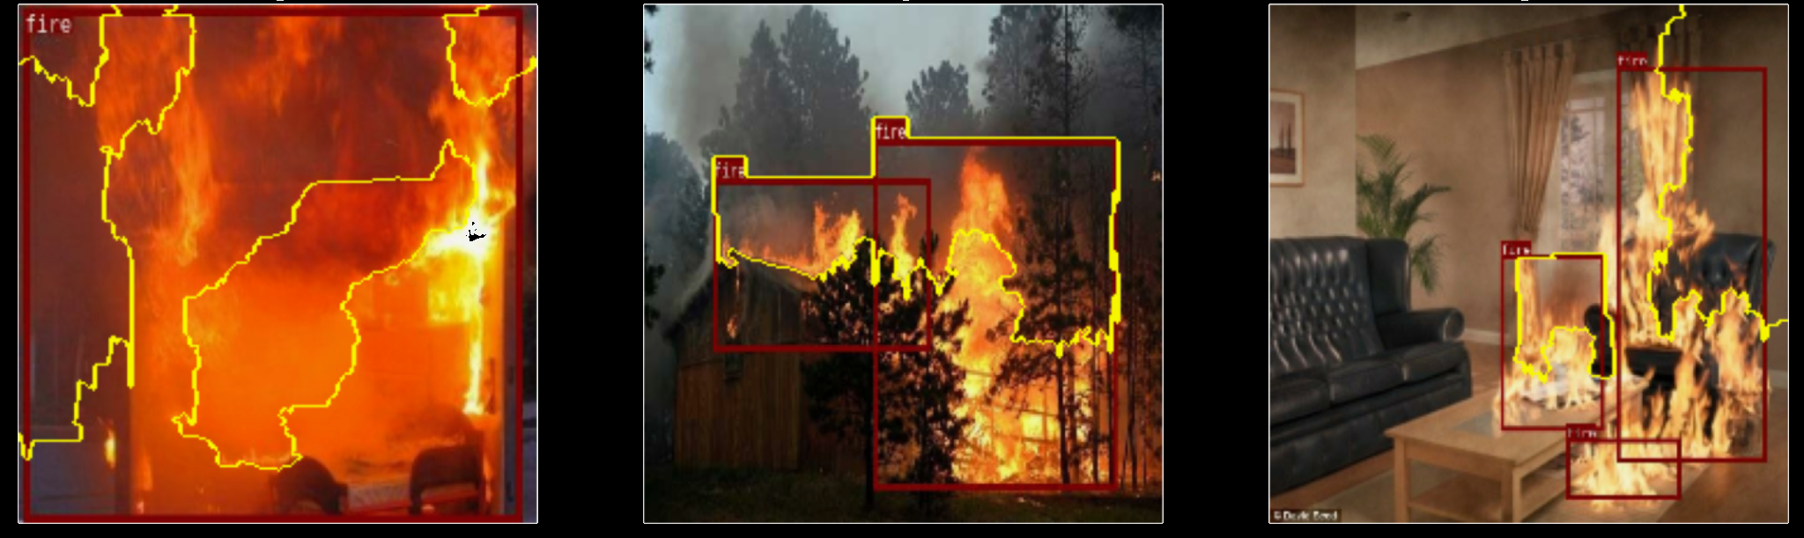
Lime large fires

Slide 20
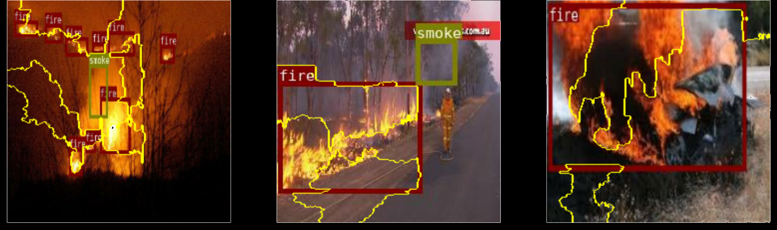
Lime medium fires

Slide 21
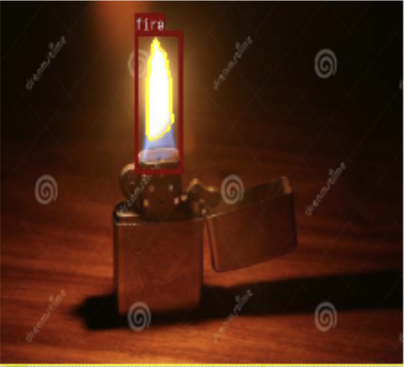
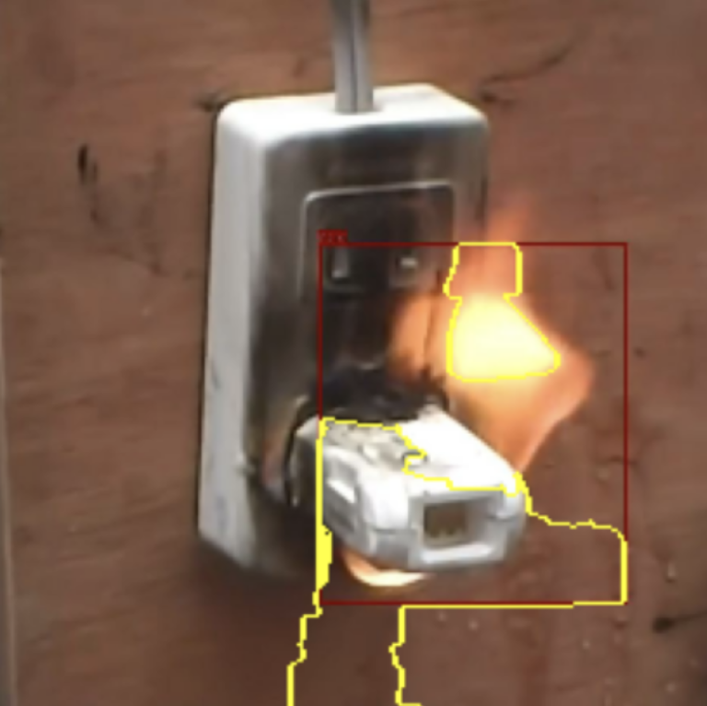
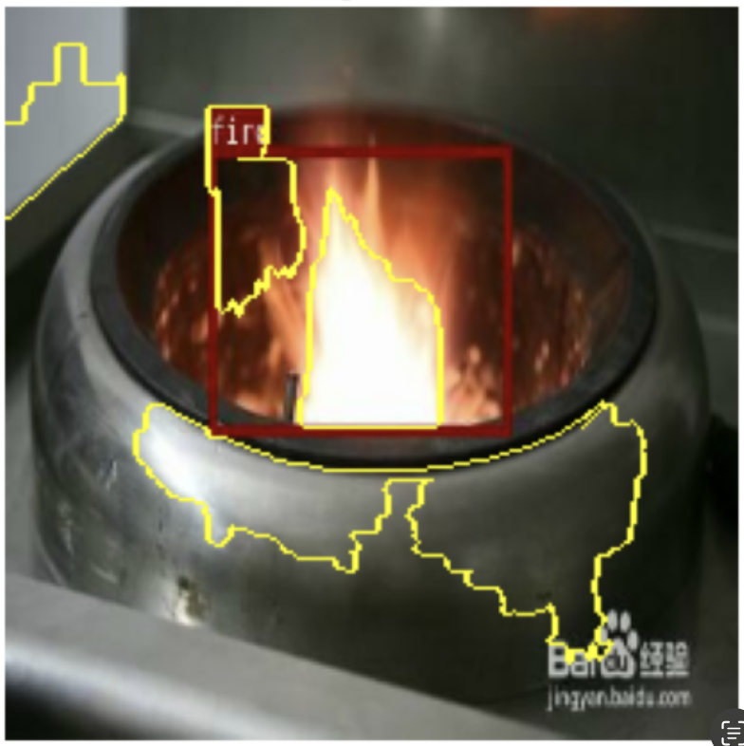
Large small fires

Slide 22
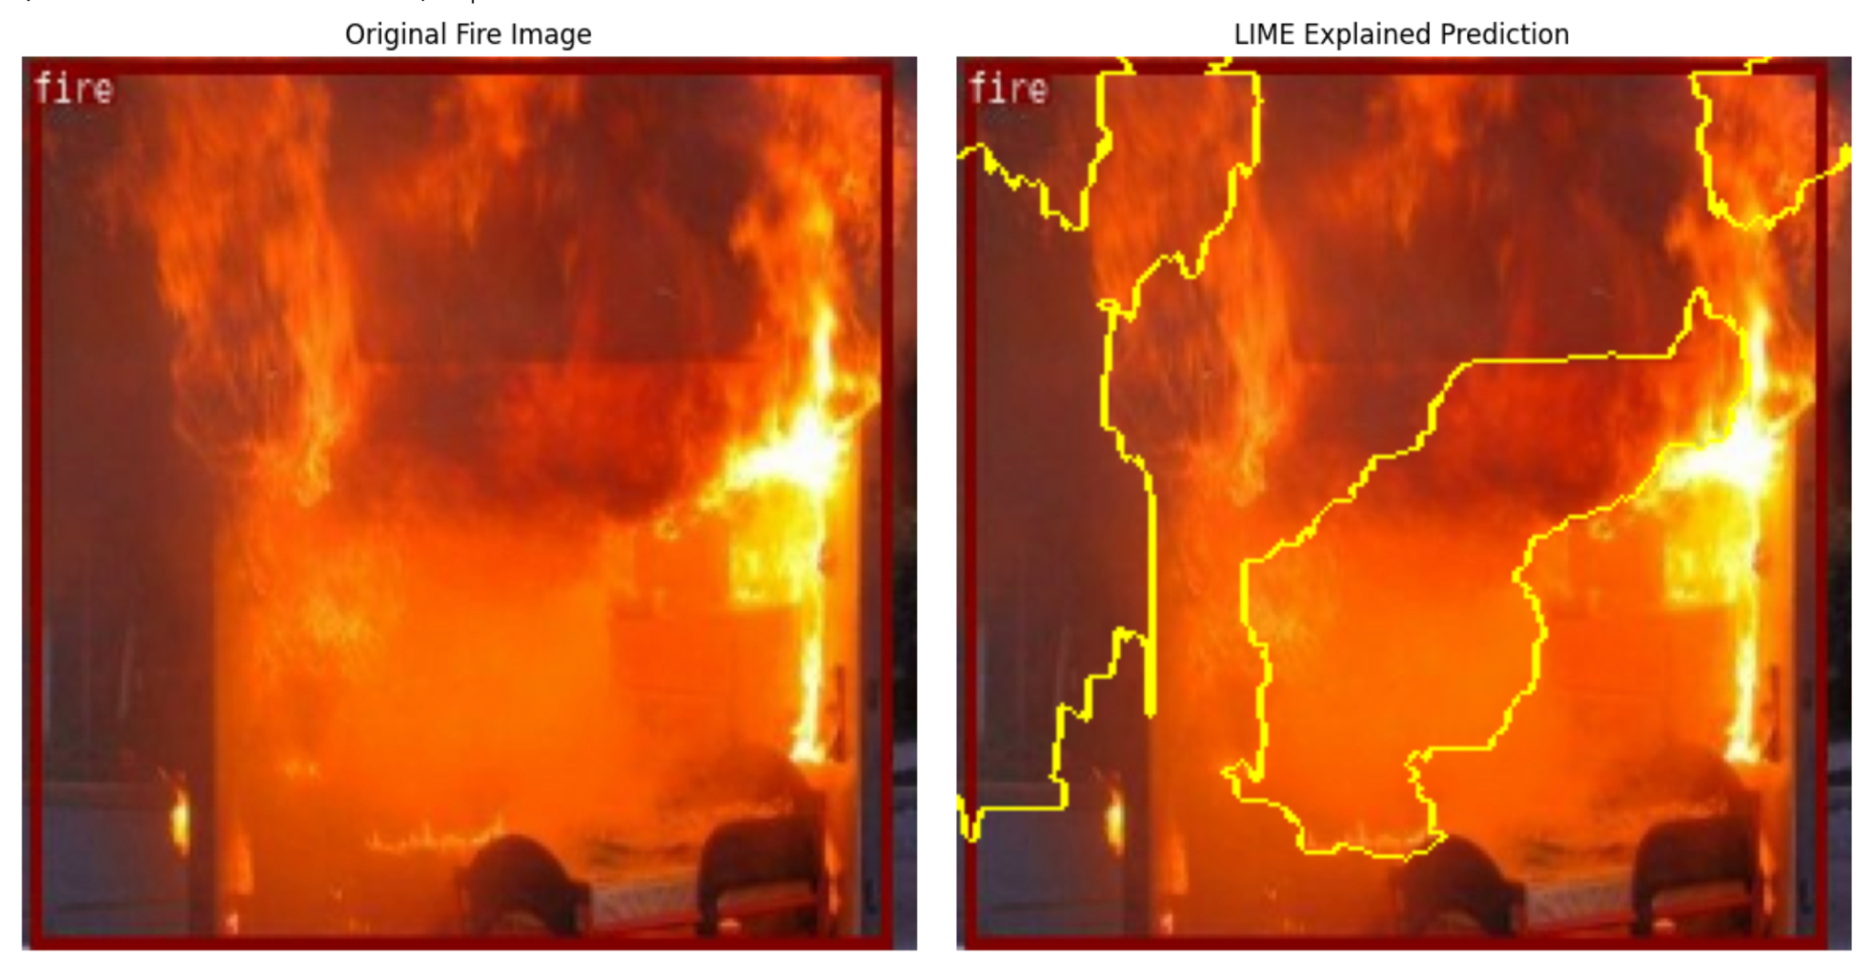
Before and after

Slide 23
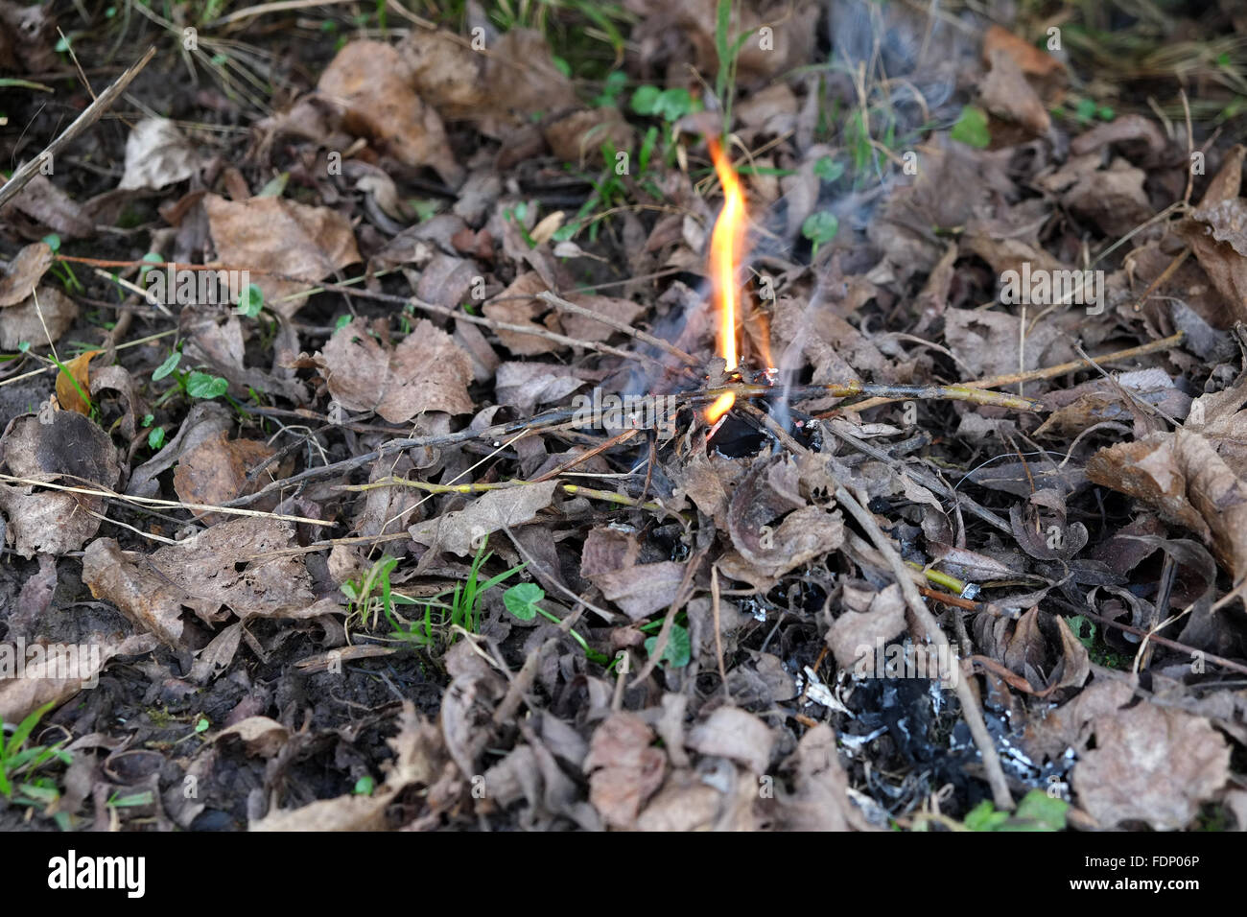
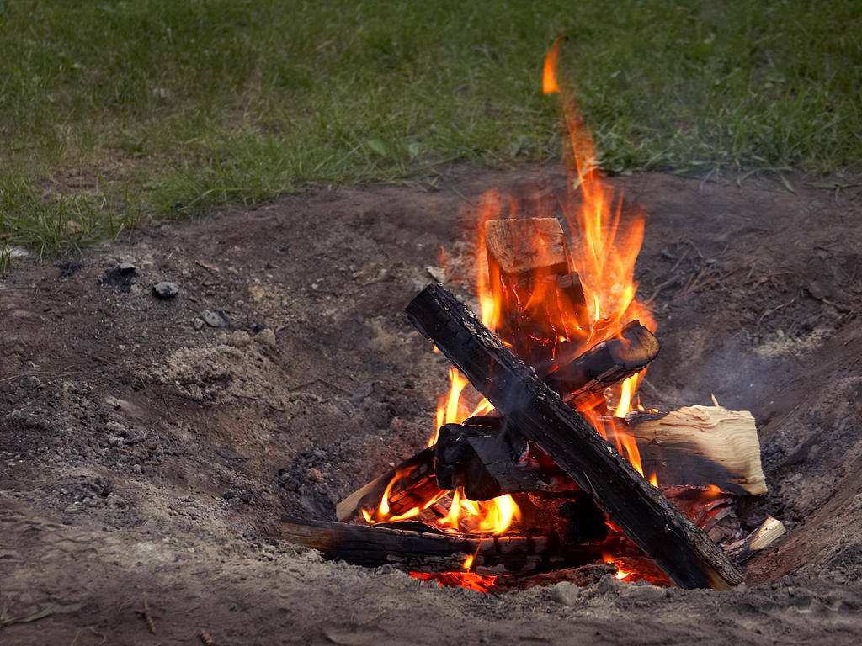
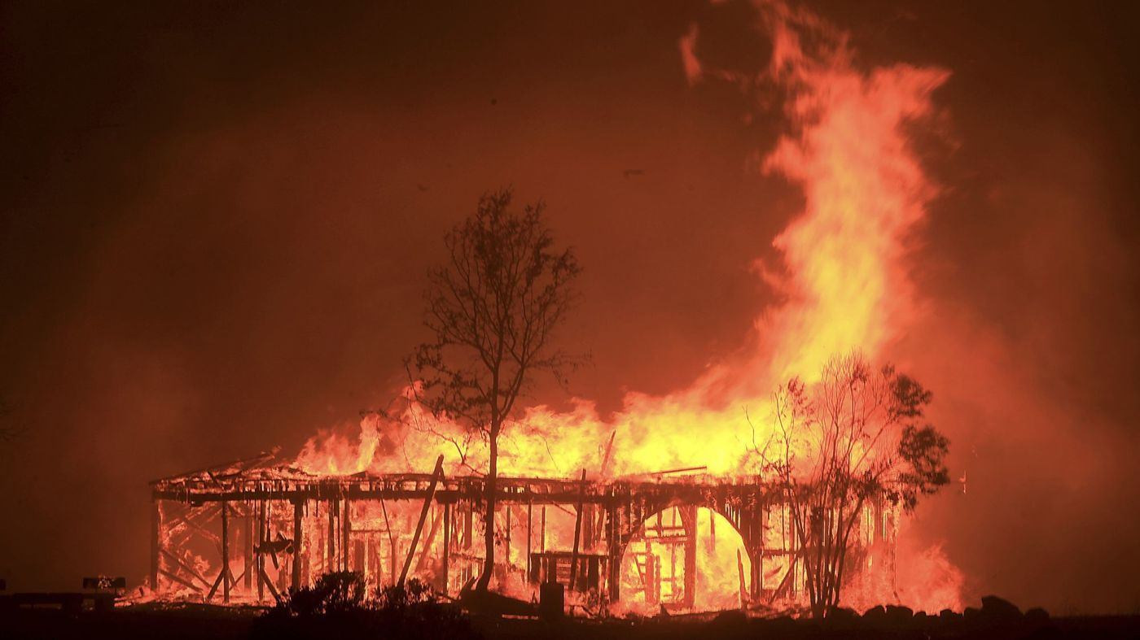
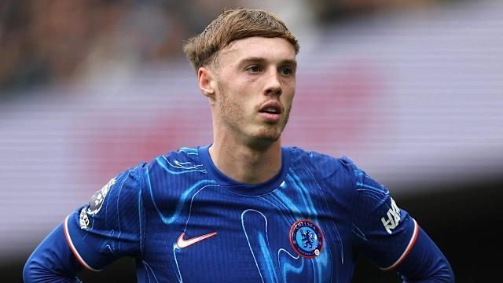
LET’S PREDICT !! (OUR OWN WEBSITE)

Slide 24
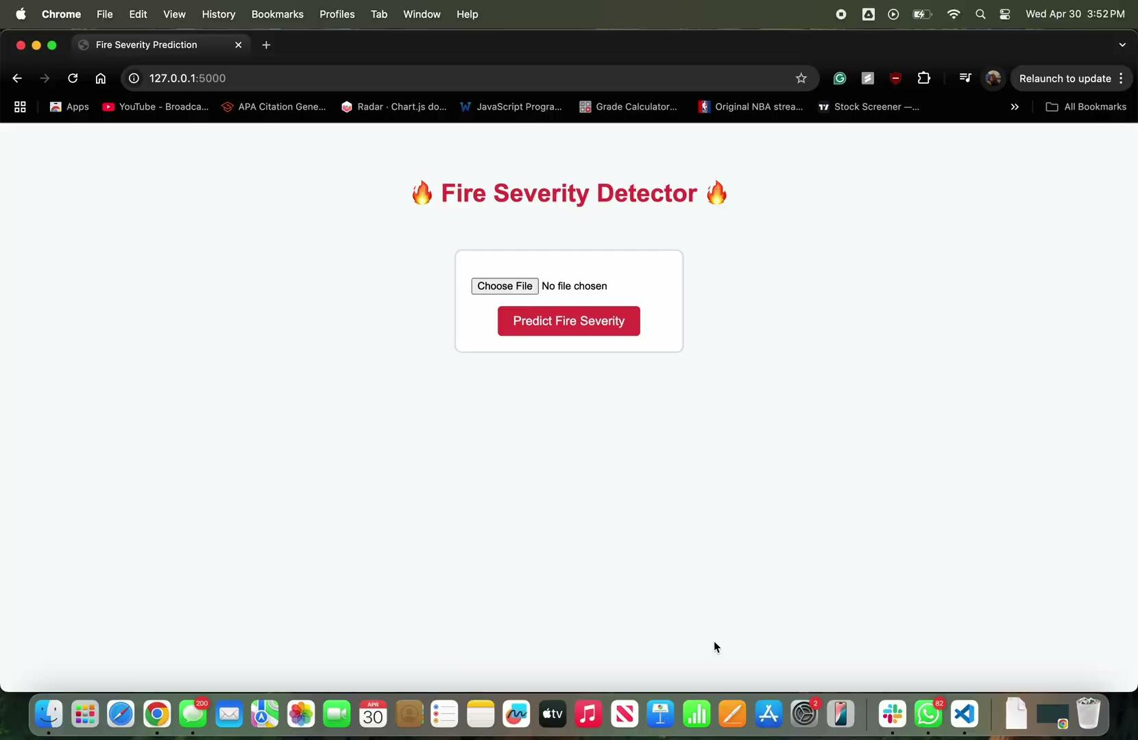
VIDEO

Slide 25
5
Challenges
& Next step

Slide 26
Challenges & Next step
Challenges:
Long training time
Model accuracy improvement
Better to overestimate than to underprepared
Out of money !!!!!!!!!
Next Step:
Zoom in and Zoom out
Create confusion matrix and focus on Recall
More small fire images
Improve model's ability to distinguish non-fire images

Slide 27
THANKS!
Please keep this slide for attribution.

